Slide 1

Microsoft Azure

Slide 2


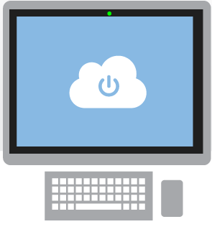
What is the cloud?
An approach to computing that’s about internet scale and connecting to a variety of devices and endpoints
Notes:
Speaking Points:
There are numerous terms and definitions floating around in the industry for “the cloud”, “cloud computing”, “cloud services”, etc.
Microsoft thinks of the cloud as simply an approach to computing that enables applications to be delivered at scale for a variety of workloads and client devices.
The cloud can help deliver IT as a standardized service…freeing you up to focus on your business

Slide 3



Cloud Computing
IaaS
PaaS
SaaS
Infrastructure-as-a-Service
Platform-as-a-Service
Software-as-a-Service
host
build
consume
Notes:
Slide Objectives:
Explain the three established industry terms for cloud services
Speaker Notes:
There is a lot of talk in the industry about different terms like Platform as a Service, Infrastructure as a Service, and Software as a Service.
Since PDC08 when we first announced the Microsoft Azure our focus has been on delivering a platform as a service offering where you can build applications. Where the platform abstracts you from the complexities of building and running applications.
We fundamentally believe that the future path forward for development is by providing a platform. In fact, as you’ll see in a few minutes, we believe that there are a number of new capabilities that should be delivered as services to the platform.
Notes:
There is a lot of confusion in the industry when it comes to the cloud.
It’s important that you understand both what is happening in the industry and how we think about the cloud.
This is the most commonly used taxonomy for differentiating between types of cloud services.
The industry has defined three categories of services:
IaaS – a set of infrastructure level capabilities such as an operating system, network connectivity, etc. that are delivered as pay for use services and can be used to host applications.
PaaS – higher level sets of functionality that are delivered as consumable services for developers who are building applications. PaaS is about abstracting developers from the underlying infrastructure to enable applications to quickly be composed.
SaaS – applications that are delivered using a service delivery model where organizations can simply consume and use the application. Typically an organization would pay for the use of the application or the application could be monetized through ad revenue.
It is important to note that these 3 types of services may exist independently of one another or combined with one another.

Slide 4
App Deployment Options
OS
HW
App
OS
HW
App
OS
HW
App
On Premises
Infrastructure as a Service
Platform as a Service
You
Azure

Slide 5
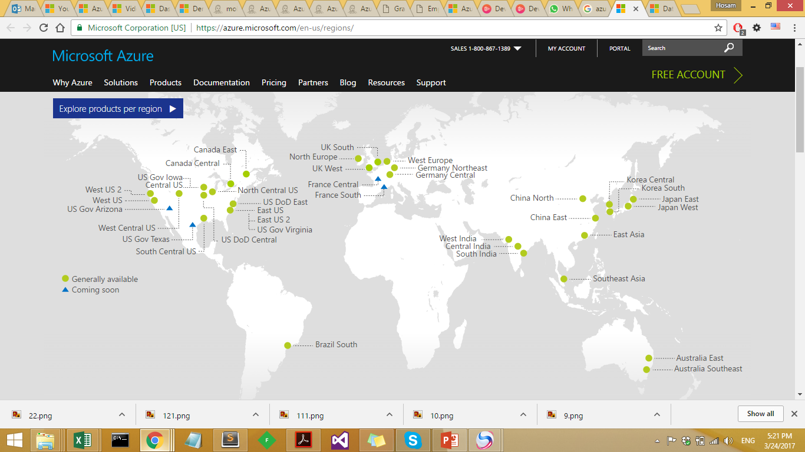
Azure is generally available in 34 regions around the world, with plans announced for 4 additional regions
Notes:
Speaking Points:
Microsoft Azure itself is deployed around the world
With Microsoft Azure, we have a concept of regions, which is where you choose to place your code and run.
In each of the regions, we have a Microsoft datacenter.
These datacenters are massive facilities that host 10s or in some cases hundreds of thousands of servers
As you can see on this slide we also have a number of CDN edge points, which we can use to cache your content and deliver it even faster for customers. %
What you’re going to see in the next couple months and years is that we will rapidly expand our datacenter footprint around the world, so you will have more options for running your applications.
Once you build an application, you can choose where you want to run in the world and you can move your workloads from region to region.
You can also run your application in multiple regions simultaneously and just direct traffic and customers to whichever version of the app is closest to them.
That gives you a global footprint and a chance to reach a bigger customer base or audience in new markets

Slide 6
Azure Data Centers
Data Centers
https://azure.microsoft.com/en-us/regions/
Azure Services Per Region
Azure Services

Slide 7
Pay only for what you use
Notes:
Speaking Points:
The final thing I’ll mention about Microsoft Azure, before we dive into the tour of services is the approach we’re taking with paying for services.
This maybe different for many of you who are familiar with hosting providers and on-premises systems.
With Microsoft Azure you pay only for what you use.
There are no upfront cost
There is no need to buy any up front server licenses, that’s just included in the price
Likewise if you use a SQL database, through our SQL Database feature in Microsoft Azure, you don’t have to buy a SQL Server license, that’s also included in the price.
For compute services such as Virtual Machines and Web Sites you only pay by the hour.
This gives you the flexibility to run your applications very cost effectively.
You can scale up and scale down your solutions or even turn them on and off as necessary.
This also opens up a ton of possibilities in terms of the new types of apps you can build

Slide 8
What will we Cover in Course
All We need to unlock Azure is Azure Subscription
Topics
Virtual Machines
SQL Database in Azure
Web Apps
Service Bus
Search Service
Function App
Notes:
In portal – press ? To get all shortcut keys available

Slide 9
Microsoft Azure Portal
Demo

